Slide 1


Artificial Intelligence and Data Science
24ADI204 Data Science and Visualization
DATA-VIZ HACK-A-BIT (2026-2027)
KidneyCare Analytics
Team Number:
GANESHKUMAR B 25BAD025
PRAJIT K 25BAD080
SAJAI SRI S 25BAD094
SANJAY V 25BAD099

Slide 2
Project Walkthrough
01. Project Scope
07. Data Cleaning
13.Key Insights /Results
02.Problem Statement
08. Outlier Handling
14.Dashboard
03. Objectives
09. EDA
15.Demo Video
04. Project Workflow
10. Correlation Analysis
16.Future Enhancements
05. Dataset Overview
11. Feature Engineering
17.Team Contribution
06. Target Variable
12. PCA
18.Conclusion/Reference

Slide 3



Project Scope
Domain: Healthcare and Public Health
Data: 400 patient records with 24 clinical indicators plus a CKD / not-CKD label
Covered: cleaning, outlier checks, EDA, scaling and encoding, feature selection, PCA, Power BI dashboard
Out of scope: clinical diagnosis or treatment advice; this is an exploratory analysis
SDG 3: Good Health and Well-being

Slide 4


Problem Statement
CKD requires analysis of multiple clinical indicators
Raw healthcare data contains missing values
Different variables have different scales
Important CKD patterns need systematic analysis
Visualization helps communicate these patterns

Slide 5


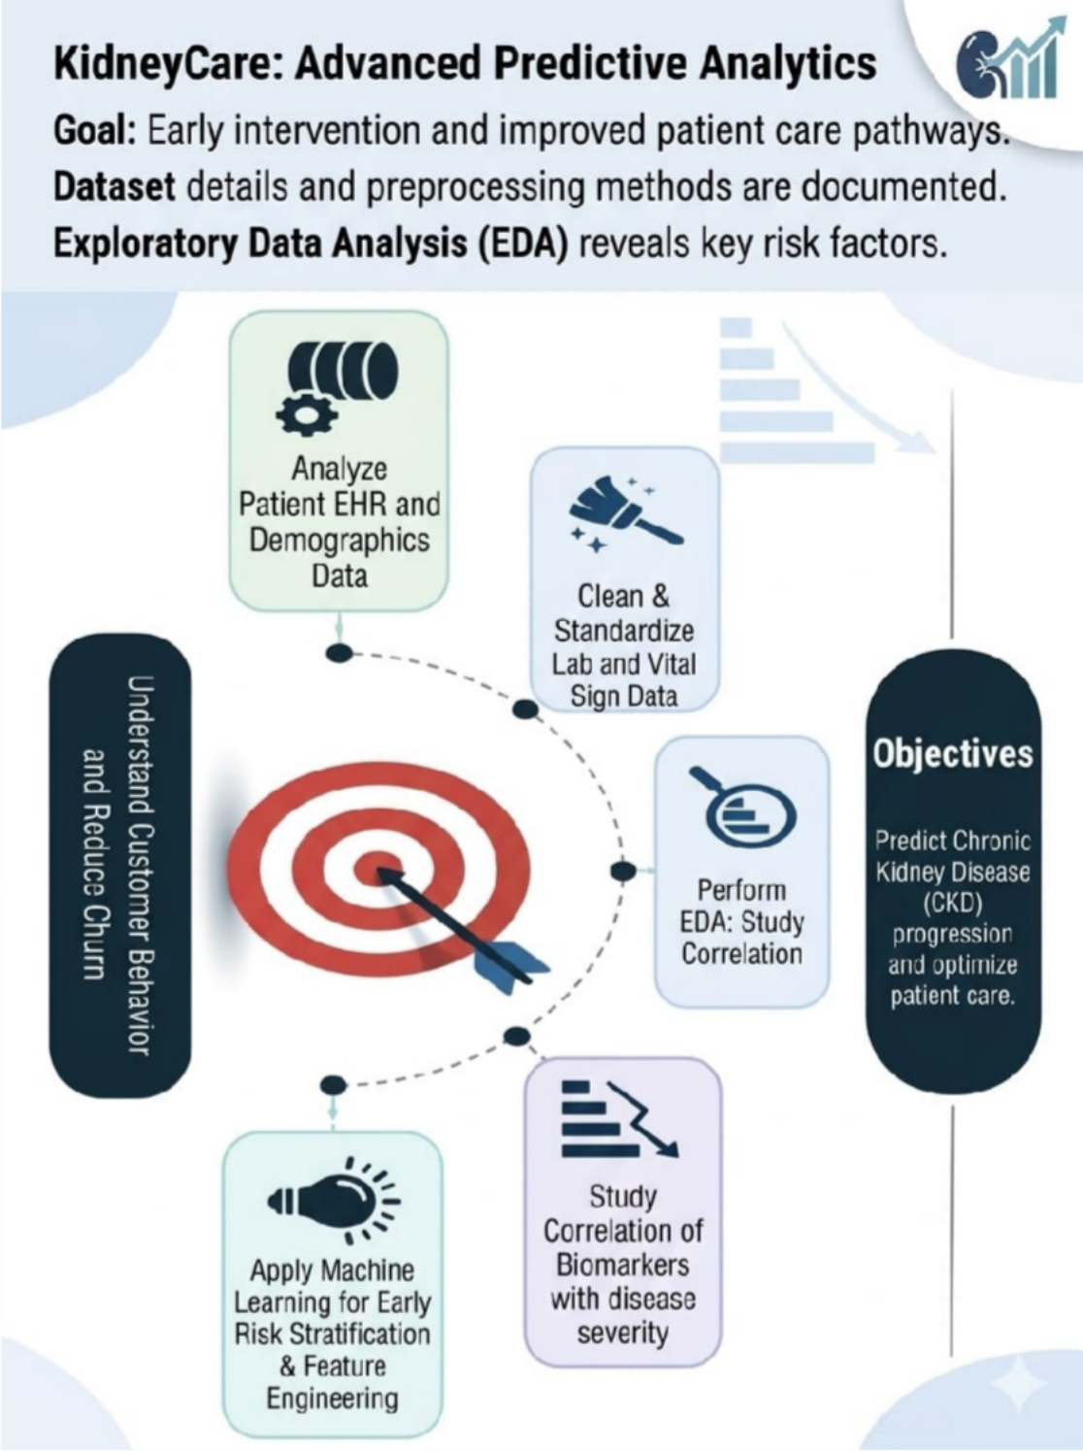
Objectives
Understand CKD dataset
Clean missing/inconsistent data
Detect potential outliers
Perform EDA and correlation analysis
Engineer and select useful features
Apply PCA
Build Power BI dashboard

Slide 6

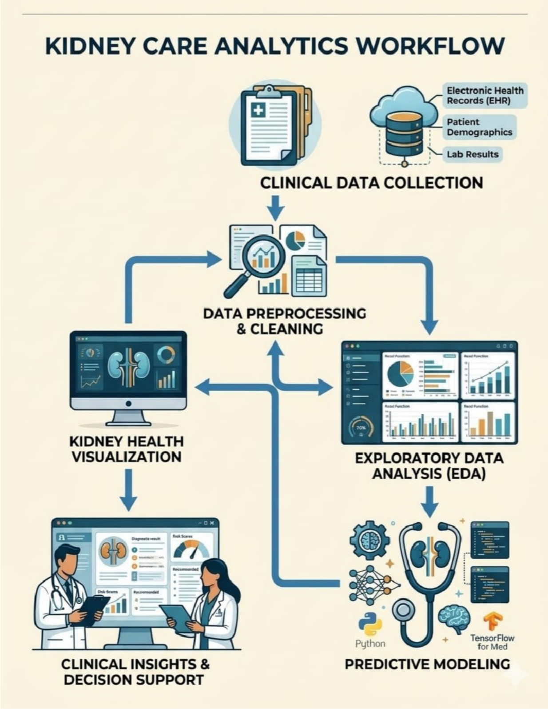
Project Workflow
Data Understanding
Cleaning
Outlier Detection
EDA
Correlation Analysis
Feature Engineering
Feature Selection
PCA
Power BI Dashboard

Slide 7

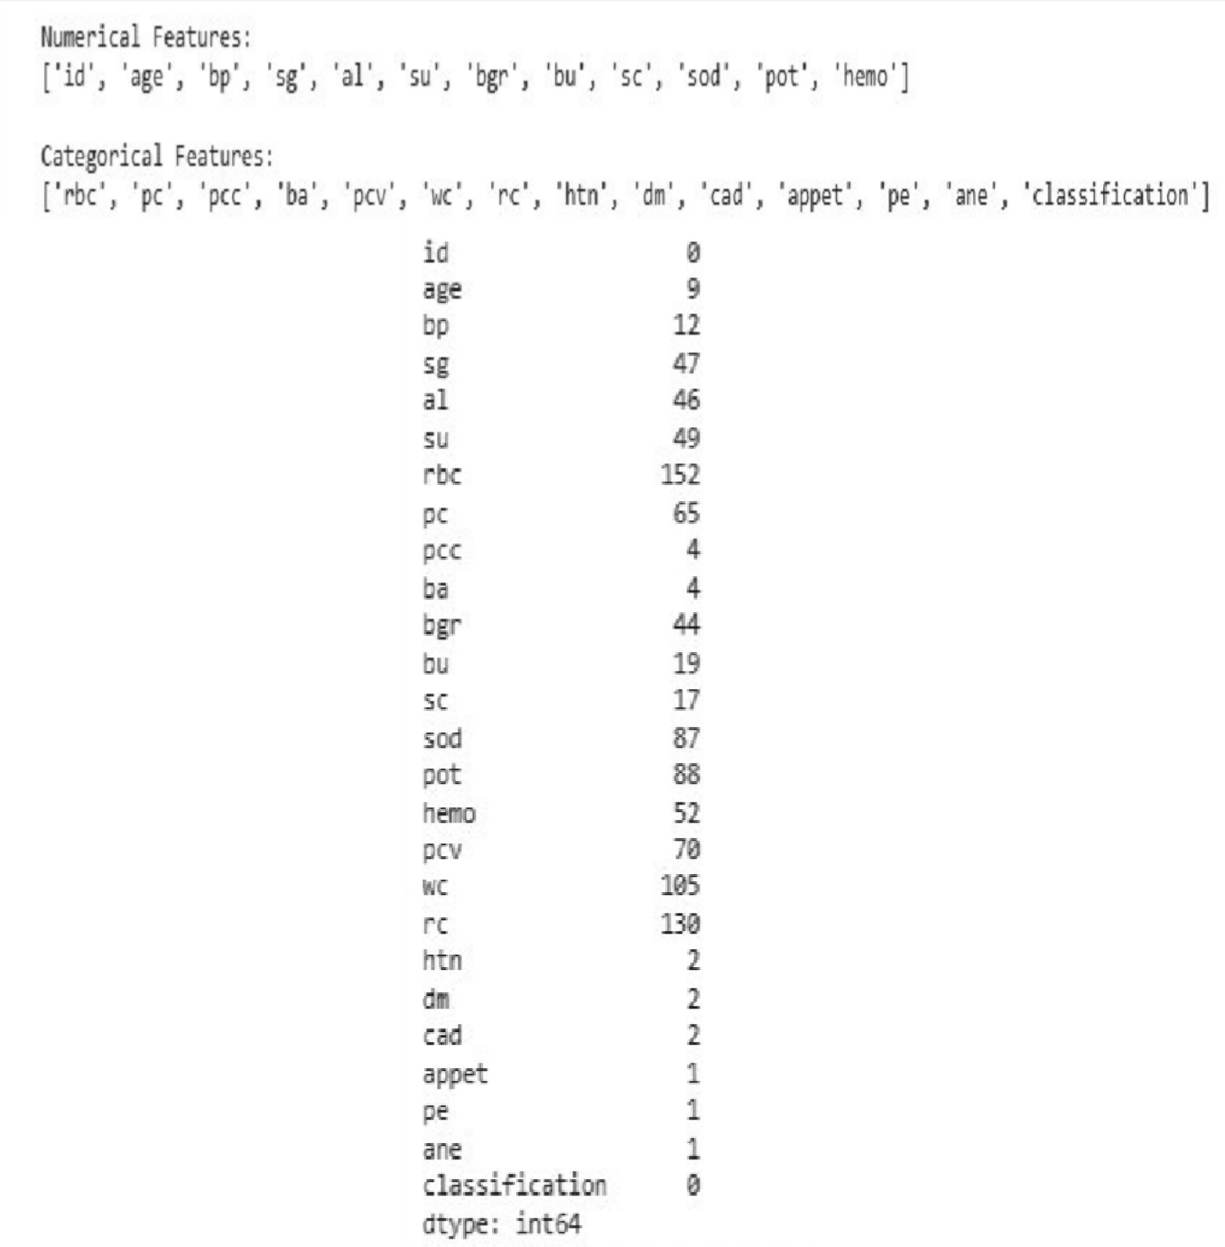
Dataset Overview
400 records
26 attributes
12 numerical features initially identified
14 categorical features
1009 missing values
0 duplicate records

Slide 8

Target Variable
Target: classification
CKD: 250 records
Non-CKD: 150 records
CKD: 62.5%
Non-CKD: 37.5%

Slide 9

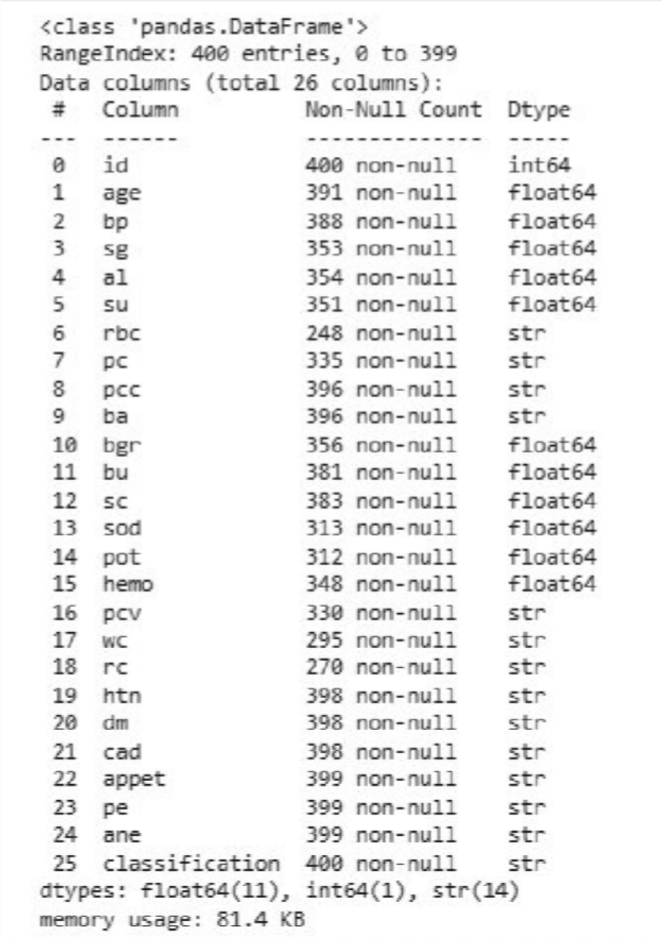
Data Cleaning
Initial missing values: 1009
Numerical → Median imputation
Categorical → Mode imputation
Duplicate records: 0
Final missing values: 0
Cleaned dataset prepared for EDA

Slide 10

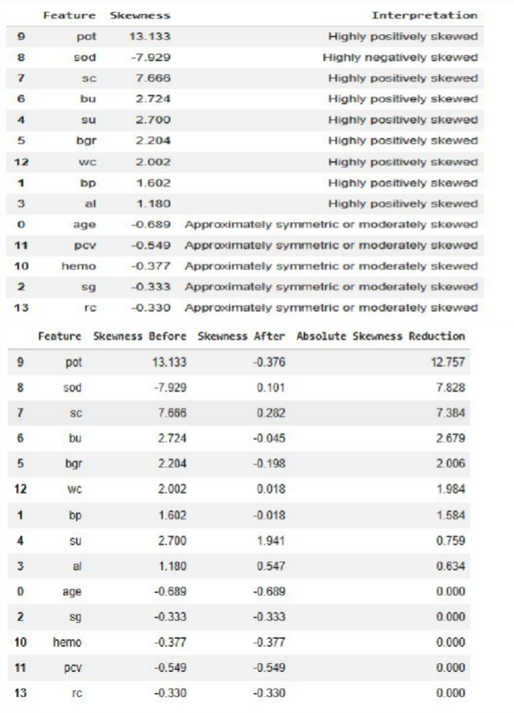
Outlier Handling
Boxplots used for visual detection
Z-score used for statistical detection
Numerical clinical features examined
Potential extreme observations identified

Slide 11

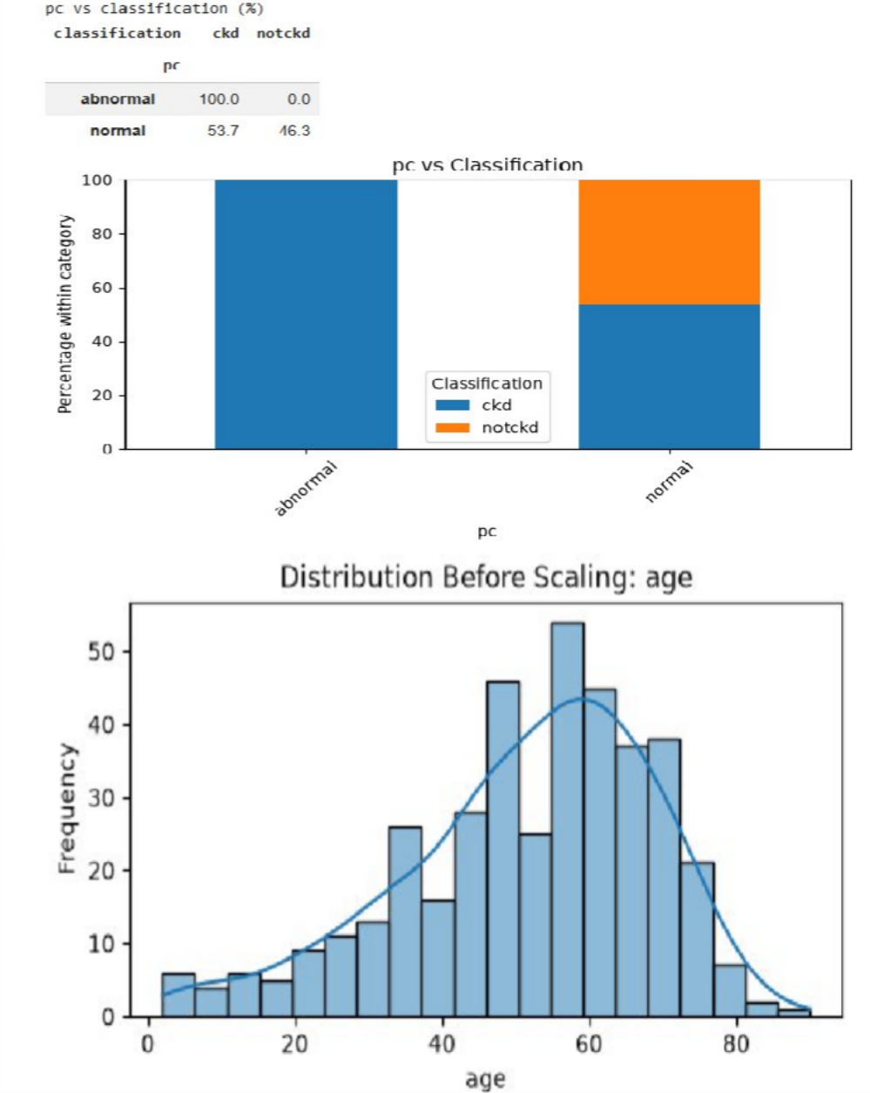
Exploratory Data Analysis
Univariate numerical analysis
Univariate categorical analysis
Bivariate numerical analysis
Bivariate categorical analysis
CKD class-wise comparisons

Slide 12

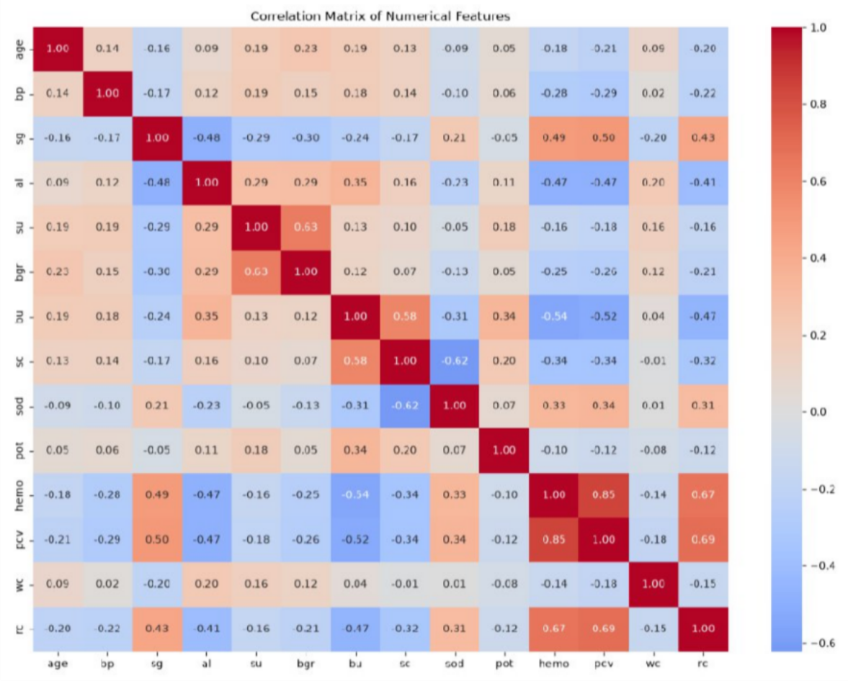
Correlation Analysis
Numerical correlation matrix generated
Relationships between clinical variables examined
Potentially redundant variables identified
Supports feature selection and PCA

Slide 13

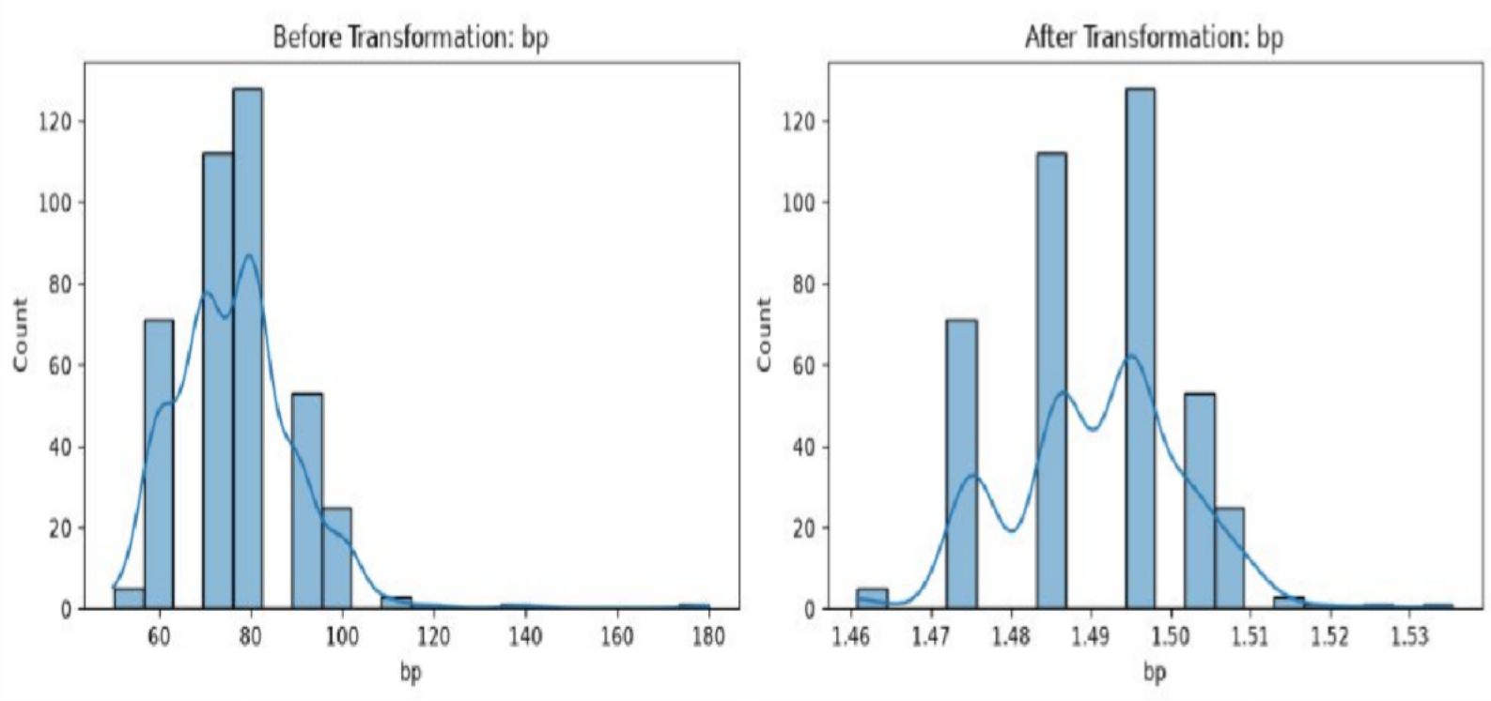
Feature Engineering
*Scaling*
StandardScaler
MinMaxScaler
*Encoding*
Binary encoding
One-hot encoding
*Skewness*
Highly skewed numerical features identified
Yeo-Johnson transformation applied

Slide 14

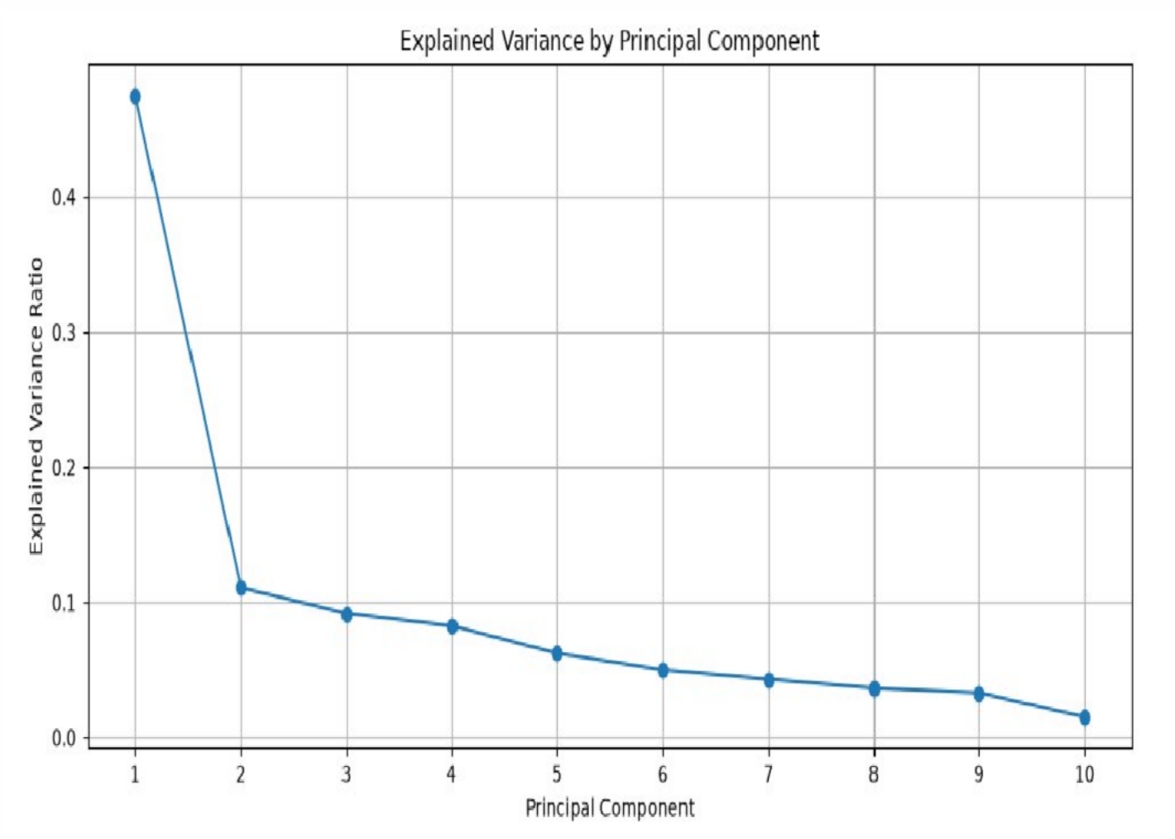
Dimensionality Reduction
*Feature Selection*
Variance analysis
Correlation analysis
SelectKBest
Top 10 features selected
*PCA*
PCA applied to selected features
7 components retained
91.55% cumulative variance

Slide 15
Key Insights / Results
400 patient records analyzed
1009 missing values addressed
CKD: 62.5%
10 important features selected
7 PCA components retained
91.55% variance retained

Slide 16

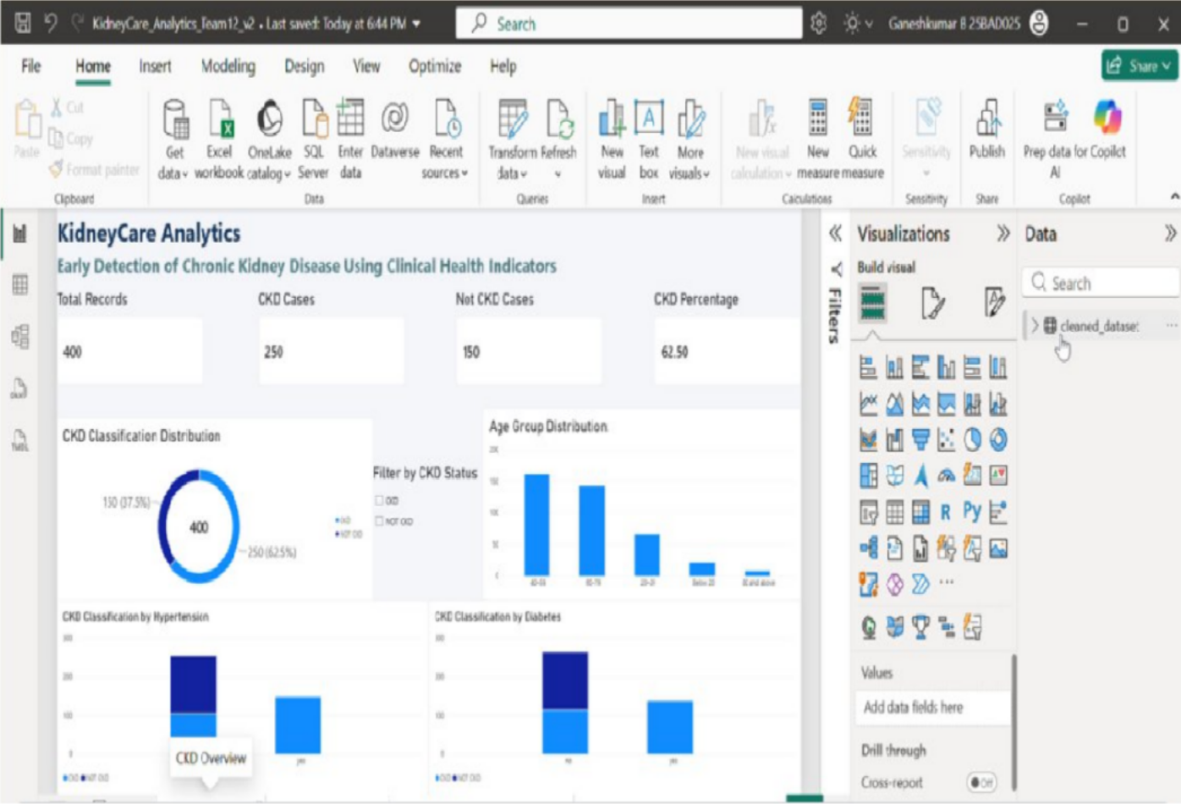
Visualization Dashboard
Interactive Power BI dashboard
CKD overview
Clinical indicators
Patient risk factors & health profile
Comparison of CKD cases

Slide 17

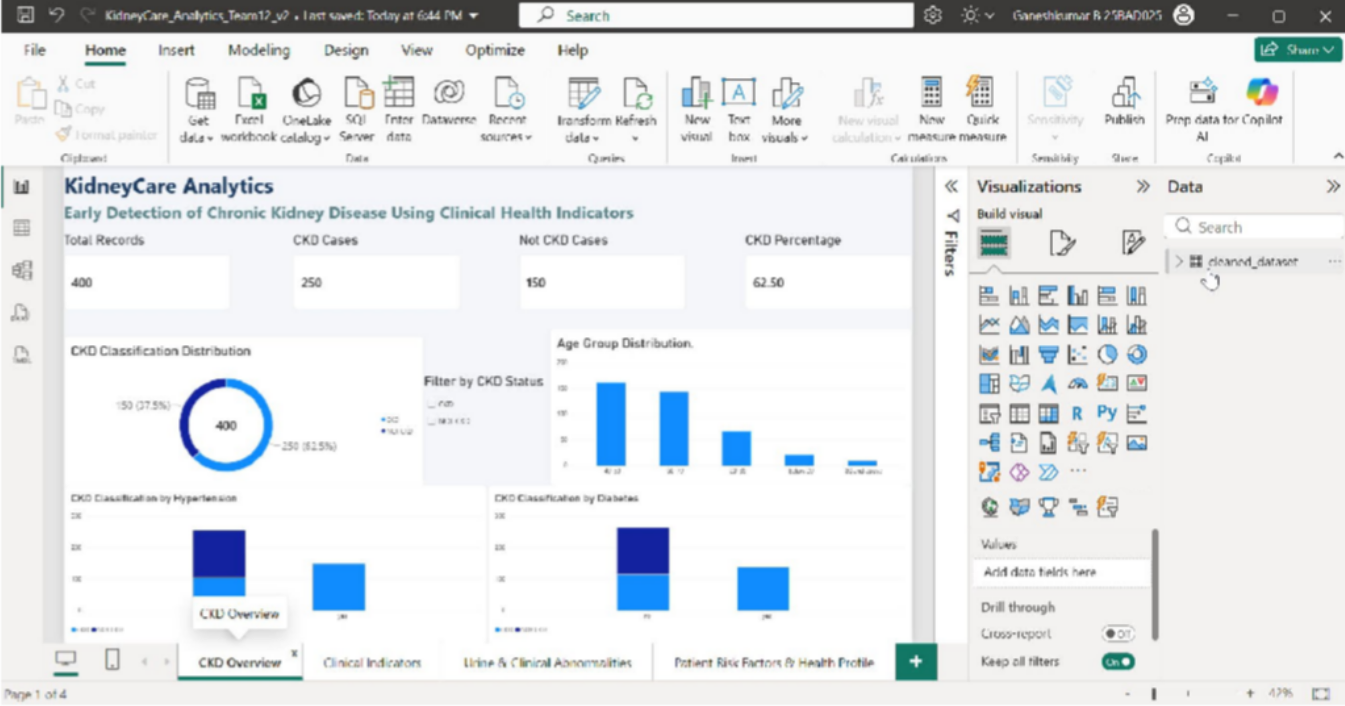
Demo Video

Slide 18

Future Enhancements
Larger CKD datasets
More clinical indicators
Longitudinal patient data
Predictive machine-learning models
Model comparison
Enhanced dashboard functionality
Real-time healthcare analytics

Slide 19

Individual Contribution
Ganeshkumar B
Project scope & problem
Dataset analysis
Numerical EDA
Scaling
Dashboard layout
Prajit K
Dataset exploration
Categorical analysis
SelectKBest
Version Management
Dashboard versions
Sajay Sri S
GitHub maintenance
Code/data updates
Encoding
Power BI visuals
Final report/Dashboard visuals
Outlier detection
Correlation analysis
Skewness transformation
PCA
File organization
Sanjay V

Slide 20

Conclusion and References
Conclusion
CKD dataset successfully analyzed
Data quality improved through preprocessing
EDA revealed useful CKD-related patterns
10 features selected
PCA reduced dimensions to 7 components
91.55% variance retained
Power BI dashboard communicated the findings interactively
References
Kaggle CKD Dataset
Pandas
NumPy
Matplotlib
Seaborn
Scikit-learn
Microsoft Power BI

